Slide 1

CONFRONTING
CHRISTIANITY

Slide 2


Good “I don’t know”:
I haven’t done the research, the thinking, or studied the Scripture carefully enough.
Bad “I don’t know”:
I continue to stay in ignorance and laziness, without trying to grow in understanding.

Slide 3
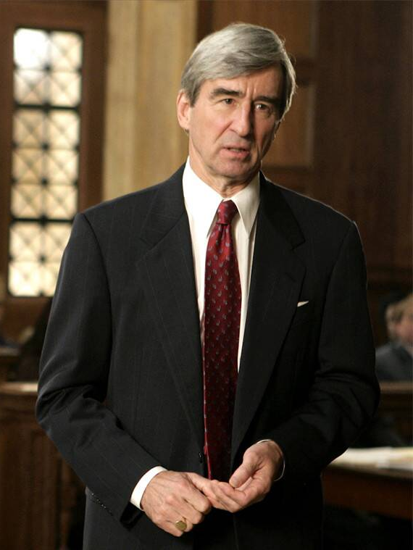
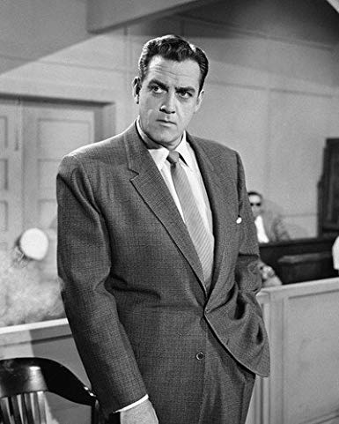
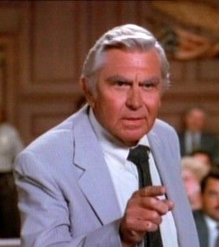
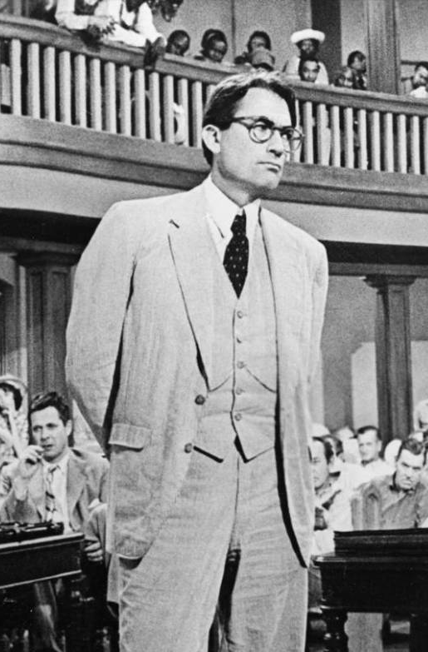
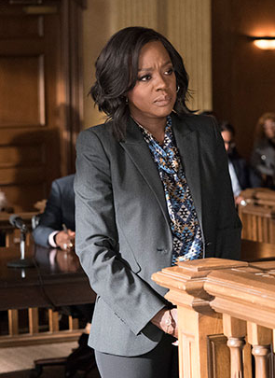
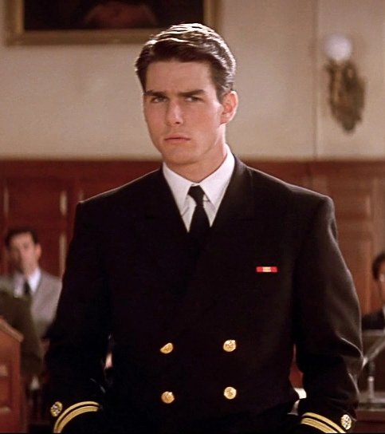
Jack McCoy
(Law & Order)
Perry Mason
(Perry Mason)
Ben Matlock
(Matlock)
Atticus Finch
(To Kill a Mockingbird)
Annalise Keating
(How to Get Away with Murder)
Daniel Kaffee
(A Few Good Men)

Slide 4







Islam
Taoism
Paganism
Pacifism
Judaism
Christianity
Sexual Rights

Slide 5


